Slide 1
Introduction
Artificial Intelligence
Machine Learning
Deep Learning
AI focuses on the ability of machines to execute intelligent tasks
ML focuses on the ability of machines to learn from data
DL is the collection of those ML models that use neural networks

Slide 2
TASK #1 Classify the following into the most specific category
01> Computer program that learns to predict future house prices using linear regression
02> Computer program to sort a list of numbers with bubble sort
03> Computer program that learns to predict future house prices using neural networks

Slide 3
TASK #1 Classify the following into the most specific category
01> Computer program that learns to predict future house prices using linear regression
Machine Learning
02> Computer program to sort a list of numbers with bubble sort
Artificial Intelligence
03> Computer program that learns to predict future house prices using neural networks
Deep Learning

Slide 4
TASK #1 Classify the following into the most specific category
01> Computer program that learns to predict future house prices using linear regression
Machine Learning
02> Computer program to sort a list of numbers with bubble sort
Artificial Intelligence
03> Computer program that learns to predict future house prices using neural networks
Deep Learning

Slide 5
What will we cover?
Different categories of ML algorithms
A general approach to supervised learning
Some supervised learning algorithms
Linear Regression
Logistic Regression
Artificial Intelligence
Machine Learning
Deep Learning
4. Deep learning basics with Artificial Neural Networks

Slide 6
Anatomy of Learning

Slide 7
1A
What are ML algorithms ?
In an ML workflow we have an entity called the model.
The model takes in an input and performs a certain task.
Initially the model performs very poorly on the given task. When the model learns it gets progressively better at the task.
Model

Slide 8
1A
What are ML algorithms ?
In an ML workflow we have some associated data available as a dataset.
This data can be tabular, audio, video etc.
It is possible to group ML algos based on the type of data they use.
Dataset

Slide 9
1A
What are ML algorithms ?
In an ML workflow there is a task that the model has to perform.
This could be prediction, classification etc.
It is possible to classify machine learning algos based on the task they are used for.
Task

Slide 10
1A
What are ML algorithms ?
A model uses ML algos to learn from data and perform a task.
As the model continues to learn from more and more data it gets better and better at performing the task.
The process of model learning from a dataset is called training.
Model
Algos
Dataset
Task
ML

Slide 11
1B Categories of ML algos
Supervised Learning Algos | Unsupervised Learning Algos
Semi-supervised Learning Algos | Reinforcement Learning Algos

Slide 12
1B
Supervised Learning Algos
Supervised learning algorithms are used when we have labelled data.
Data is said to be labelled when they are of format (input, output)
These algorithms benefit from knowing the expected output, thus allowing us to create efficient ML systems.

Slide 13
1B
Unsupervised Learning Algos
Unsupervised learning algorithms are used when we have unlabelled data.
Data is said to be unlabelled when the expected output is missing in the data.
Most raw data is unlabelled, these algorithms help find patterns in such data.

Slide 14
1B
Semi-supervised Learning Algos
Semi-supervised learning algorithms are used when we have a limited amount of labelled data along with a large amount of unlabelled data.
These algorithms use a mix of supervised and unsupervised learning approaches to learn from this mixed proportion of data.

Slide 15
1B
Reinforcement Learning Algos
Reinforcement learning algorithms requires an agent to learn through its interactions with its environment.
This is a reward based system, so the agent is rewarded for every correct action and penalized for every incorrect one.
AI is being trained to play games using this approach.

Slide 16
TASK #2 Classify the following into the most relevant category
01> System to | differentiate | between | cats | and
dogs, trained | on a labelled | dataset
02> An AI system capable of playing Pac-Man
03> Group similar iris flowers based on sepal and petal length using an unlabelled dataset
04> Music Genre classifier built on a largely unlabelled dataset.

Slide 17
TASK #2 Classify the following into the most relevant category
01> System to differentiate between cats and dogs, trained on a labelled dataset
Supervised Learning
02> An AI system capable of playing Pac-Man
Reinforcement Learning
03> Group similar iris flowers based on sepal and petal
length using an unlabelled dataset
Unsupervised Learning
04> Music Genre classifier built on a largely unlabelled dataset.
Semi-supervised Learning

Slide 18
Our Focus
Supervised Learning Algos | Unsupervised Learning Algos
Semi-supervised Learning Algos | Reinforcement Learning Algos

Slide 19
Anatomy of SUPERVISED Learning

Slide 20
2B
Overview
Optimization Algo
input
Model
Prediction
Dataset
expected output
Loss Function
Loss

Slide 21
2C
Model
The model is simply a mathematical function, that takes an input and produces an output. The output of the model is called prediction.
Every model has certain parameters. Initially they are set to random values causing the model to output incorrect results. However during training they are tuned to produce the desired output.
The entire process of learning is about learning the right value for these parameters!
Model
Prediction

Slide 22
2D
Loss Function
When the model generates a prediction for an input, we need a way to inform the model if that prediction is correct or how much of it is correct.
This is done by comparing the prediction with the expected output.
The loss function computes the difference between the prediction and expected output and returns the result which is often called loss.
Prediction
Dataset
expected output
Loss Function
Loss

Slide 23
2E
Optimization Algorithm
This algorithm tries to reduce the difference indicated by the loss function.
This is done by tuning the parameters of the model so that the output generated by the model is more closer to the expected output.
Optimization algorithms provide a method of systematically updating model parameters so that model gets better and better.
Loss
Optimization Algo
Model

Slide 24
2E
Optimization Algorithm
Gradient Descent
Parameters start with a random value, the aim of gradient descent is to find the gradient of the parameters with respect to the loss and then try to move in the direction of the minima.
The formula below is for updating a parameter. Let be the parameter and J the loss.
is the learning rate, this decides the size of the step taken.
θ = θ − α ^{∂J}
∂θ

Slide 25
2E
Putting it together
Data is fed into the model, the model makes a prediction for each input.
The loss function computes the difference between the prediction and expected output.
The optimization algorithm then tries to reduce the loss by tuning the parameters in the model.
This repeats over the entire dataset multiple times.
Eventually the model parameters reach a local minima and the model generates accurate predictions.

Slide 26
3A Linear Regression
Gradient Descent
input
R = αA + β
Prediction
(No of rooms, price)
expected output
LSE = ¹ (y − y
₎2
Loss
2
pred expected

Slide 27
4F Putting it together
Gradient Descent
input
Z = Sigmoid(αA + β)
Prediction
(Size of tumor,
malignancy)
expected output
BCE Loss
Loss

Slide 28
4D
Model
1. To solve the problem we use the sigmoid activation function. The formula for sigmoid is as given below.
1
1
Sigmoid(x) =
1 + e^{−x}
0.5
-5 -4 -3 -2 -1 0 1 2 3 4 5 6
2. Our modified formula can now be
Z > threshold, R = 1
Z < threshold, R = 0
Z = Sigmoid(αA + β)

Slide 29
4E
Loss Function
We can’t use the linear regression loss function here since it will provide in sufficient information for effective training.
Binary Cross Entropy (BCE) Loss is a very common loss used for classification tasks.
BCE = − log p, y = 1
BCE = − log 1 − p, y = 0

Slide 30
5B
Overview of ANN
Optimization Algo
input
ANNs
Prediction
Dataset
expected output
Loss Function
Loss

Slide 31
5C
Structure of a Neural Network
Inputs
Input Layer
Hidden Layer
Output Layer

Slide 32
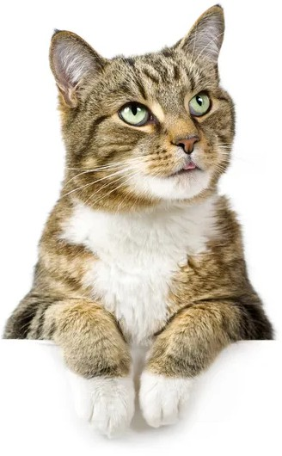
5E
Let’s create an ANN!
Inputs
Chance of image being a cat
Chance of image being a dog

Slide 33
5F
Forward Propagation
Inputs
3
W1=5, B=2
W1=8, W2=5 B=1
W1=3, W2=6 B=11
17
2
W1=7, B=4
18
3
W1=2, B=6
12
W1=7, W2=1 B=0
W1=4, W2=9 B=3

Slide 34
5F
Forward Propagation
Inputs
3
W1=5, B=2
W1=8, W2=5 B=1
W1=3, W2=6 B=11
17
32
2
W1=7, B=4
18
54
3
W1=2, B=6
12
W1=7, W2=1 B=0
W1=4, W2=9 B=3

Slide 35
5F
Forward Propagation
Inputs
3
W1=5, B=2
W1=8, W2=5 B=1
W1=3, W2=6 B=11
17
32
0.2
2
W1=7, B=4
18
54
0.8
3
W1=2, B=6
12
W1=7, W2=1 B=0
W1=4, W2=9 B=3

Slide 36
5F
Forward Propagation
Inputs
3
W1=5, B=2
W1=8, W2=5 B=1
W1=3, W2=6 B=11
17
32
0.2
2
W1=7, B=4
18
DOG
54
0.8
3
W1=2, B=6
12
W1=7, W2=1 B=0
W1=4, W2=9 B=3

Slide 37

5F
Forward Propagation
Inputs
3
W1=5, B=2
W1=8, W2=5 B=1
W1=3, W2=6 B=11
17
32
0.2
2
W1=7, B=4
18
DOG
54
0.8
3
W1=2, B=6
12
W1=7, W2=1 B=0
W1=4, W2=9 B=3

Slide 38
5F
Backward Propagation
Inputs
3
W1=5, B=2
W1=8, W2=5 B=1
W1=5, W2=11 B=3
2
W1=7, B=4
LOSS
3
W1=2, B=6
W1=7, W2=1 B=0
W1=2, W2=4 B=1

Slide 39
5F
Backward Propagation
Inputs
3
W1=5, B=2
W1=6 W2=2 B=5
W1=5, W2=11 B=3
2
W1=7, B=4
LOSS
3
W1=2, B=6
W1=3, W2=5 B=2
W1=2, W2=4 B=1

Slide 40
5F
Backward Propagation
Inputs
3
W1=7, B=1
W1=6 W2=2 B=5
W1=5, W2=11 B=3
2
W1=4, B=2
LOSS
3
W1=8, B=1
W1=3, W2=5 B=2
W1=2, W2=4 B=1

Slide 41
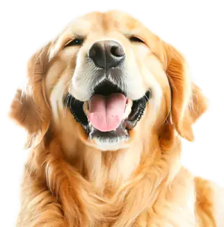
5G
ANN Learning
Inputs
8
W1=7, B=1
W1=6 W2=2 B=5
W1=5, W2=11 B=3
32
5
W1=4, B=2
24
7
W1=8, B=1
43
W1=3, W2=5 B=2
W1=2, W2=4 B=1

Slide 42
5G
ANN Learning
Inputs
8
W1=7, B=1
W1=6 W2=2 B=5
W1=5, W2=11 B=3
32
63
5
W1=4, B=2
24
78
7
W1=8, B=1
43
W1=3, W2=5 B=2
W1=2, W2=4 B=1

Slide 43
5G
ANN Learning
Inputs
8
W1=7, B=1
W1=6 W2=2 B=5
W1=5, W2=11 B=3
32
63
0.6
5
W1=4, B=2
24
78
0.4
7
W1=8, B=1
43
W1=3, W2=5 B=2
W1=2, W2=4 B=1

Slide 44
5G
ANN Learning
Inputs
8
W1=7, B=1
W1=6 W2=2 B=5
W1=5, W2=11 B=3
32
63
0.6
5
W1=4, B=2
24
CAT
78
0.4
7
W1=8, B=1
43
W1=3, W2=5 B=2
W1=2, W2=4 B=1

Slide 45
5G
ANN Learning
Inputs
8
W1=7, B=1
W1=6 W2=2 B=5
W1=5, W2=11 B=3
32
63
0.6
5
W1=4, B=2
24
CAT
78
0.4
7
W1=8, B=1
43
W1=3, W2=5 B=2
W1=2, W2=4 B=1

Slide 46
5G
ANN Learning
Inputs
8
W1=7, B=1
W1=6 W2=2 B=5
W1=7, W2=3 B=2
5
W1=4, B=2
LOSS
7
W1=8, B=1
W1=3, W2=5 B=2
W1=3, W2=6 B=3

Slide 47
5G
ANN Learning
Inputs
8
W1=7, B=1
W1=4 W2=8 B=3
W1=7, W2=3 B=2
5
W1=4, B=2
LOSS
7
W1=8, B=1
W1=6, W2=2 B=2
W1=3, W2=6 B=3

Slide 48
5G
ANN Learning
Inputs
8
W1=4, B=5
W1=4 W2=8 B=3
W1=7, W2=3 B=2
5
W1=2, B=1
LOSS
7
W1=5, B=7
W1=6, W2=2 B=2
W1=3, W2=6 B=3

Slide 49
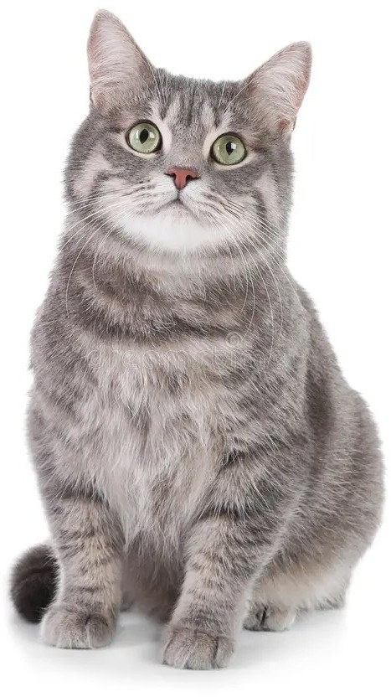
5G
ANN Learning
Inputs
2
W1=4, B=5
W1=4 W2=8 B=3
W1=7, W2=3 B=2
12
3
W1=2, B=1
15
2
W1=5, B=7
19
W1=6, W2=2 B=2
W1=3, W2=6 B=3

Slide 50
5G
ANN Learning
Inputs
2
W1=4, B=5
W1=4 W2=8 B=3
W1=7, W2=3 B=2
12
36
3
W1=2, B=1
15
19
2
W1=5, B=7
19
W1=6, W2=2 B=2
W1=3, W2=6 B=3

Slide 51
5G
ANN Learning
Inputs
2
W1=4, B=5
W1=4 W2=8 B=3
W1=7, W2=3 B=2
12
36
0.9
3
W1=2, B=1
15
19
0.1
2
W1=5, B=7
19
W1=6, W2=2 B=2
W1=3, W2=6 B=3

Slide 52
5G
ANN Learning
Inputs
2
W1=4, B=5
W1=4 W2=8 B=3
W1=7, W2=3 B=2
12
36
0.9
3
W1=2, B=1
15
CAT
19
0.1
2
W1=5, B=7
19
W1=6, W2=2 B=2
W1=3, W2=6 B=3

Slide 53

5G
ANN Learning
Inputs
2
W1=4, B=5
W1=4 W2=8 B=3
W1=7, W2=3 B=2
12
36
0.9
3
W1=2, B=1
15
CAT
19
0.1
2
W1=5, B=7
19
W1=6, W2=2 B=2
W1=3, W2=6 B=3

